Slide 1
about:OBS
Conference/event name
Location
name
openSUSE Ambassador
name@opensuse.org
Notes:
The beginning...

Slide 2
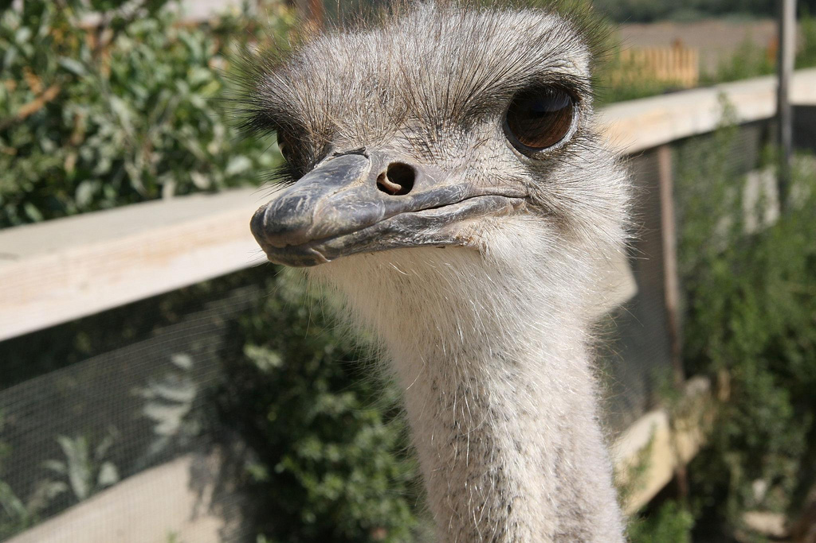
​
Notes:
about yourself!

Slide 3
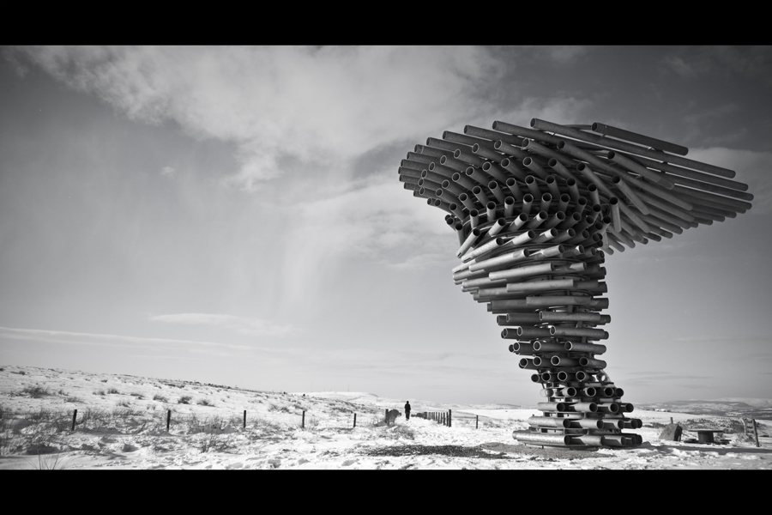
Building something?
​
Notes:
The problem to solve: As developer you write software. How to get the product to many linux distro's and even other platforms?
​
Not an issue for established projects like Gimp or KDE but it is for new applications!

Slide 4
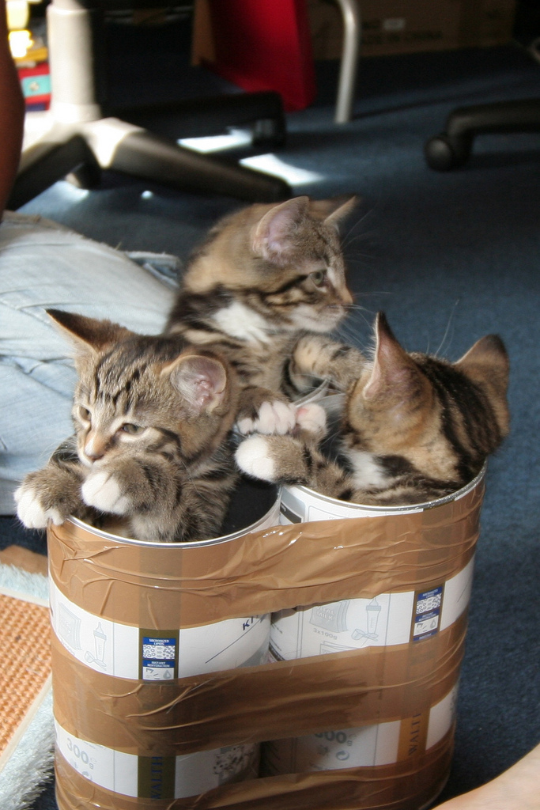
Packages
Notes:
solution: the Open Build Service
OBS can build packages for any distro or platform – via web browser or command line
OBS is used by VLC to build packages even for windows – that's how flexible it is.
OBS is Free Software and used by MeeGo and openSUSE to build their whole linux distributions, and by many other projecs, universities anc companies to build packages.

Slide 5

OBS...
Free
on
build.opensuse.org
160.000
users
30.000
packages
24
6
distributions
Architectures
Notes:
build.opensuse.org currently builds more than 120.000 packages by almost 30.000 developers for 21 operating systems and 6 architectures. Yes, that includes the latest releases of debian and fedora, 32 and 64 bit and arm; we even have experimental windows support.
Sponsored by Novell, AMD, IP Exchange and B1 Systems.
Let's go through some features!

Slide 6
OBS...
RPM
DEB
TGZ
EXE
Virtual Machine
Notes:
OBS builds packages by spawning a VM, installing build dependencies, getting source from a tarball or directly from a repository like SVN or git, executing build and feeding results (package or errors) back to the developer. This makes OBS OS/platform independent.
* If other packages depend on what you build, they will be rebuild automatically.
OBS supports LiveCD/VM images; and they will also automatically rebuild if a dependency changes.

Slide 7
OBS...
Meego
Intel
Nokia
Linux Foundation
VLC
OCS
Cray
Dell
Notes:
* teams can work together on a subset of packages in projects:maintainers, access rights, merge requests etc etc
* Developed together with Intel, Nokia, Linux Foundation, Cray and many others. It is fully Free Software – feel free to download our OBS LiveCD to have your own Open Build Service up and running in no-time!

Slide 8

Notes:
Screenshot time.
Let's build a package on OBS and submit it to a project!

Slide 9
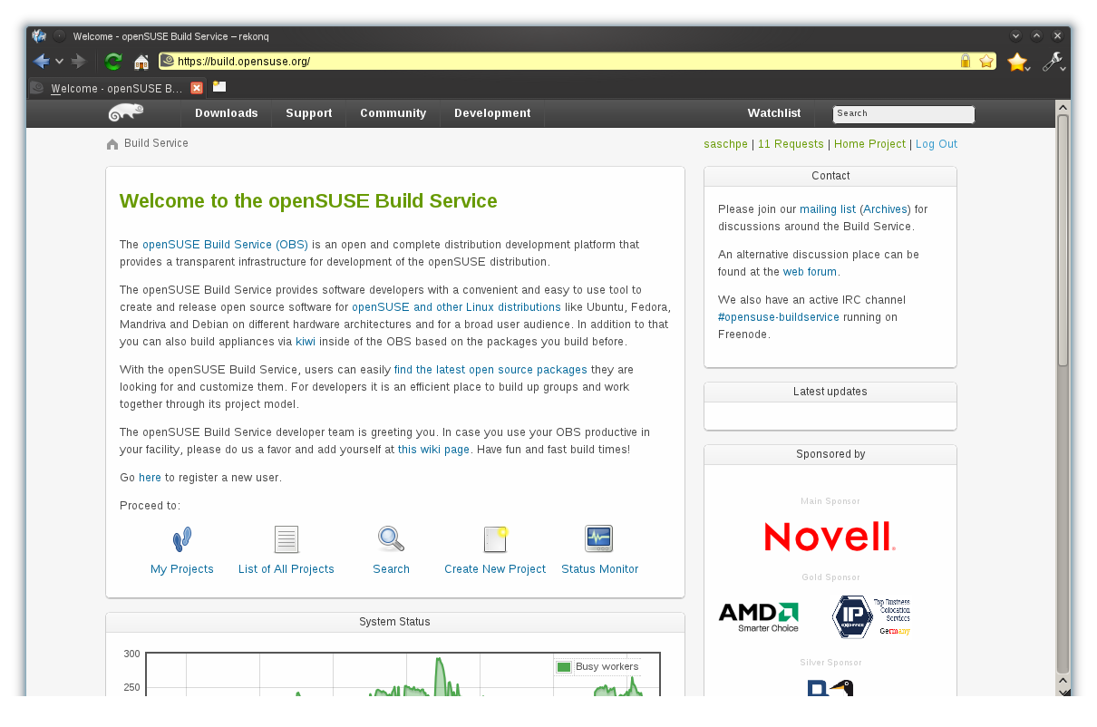
Notes:
Welcome to OBS!

Slide 10
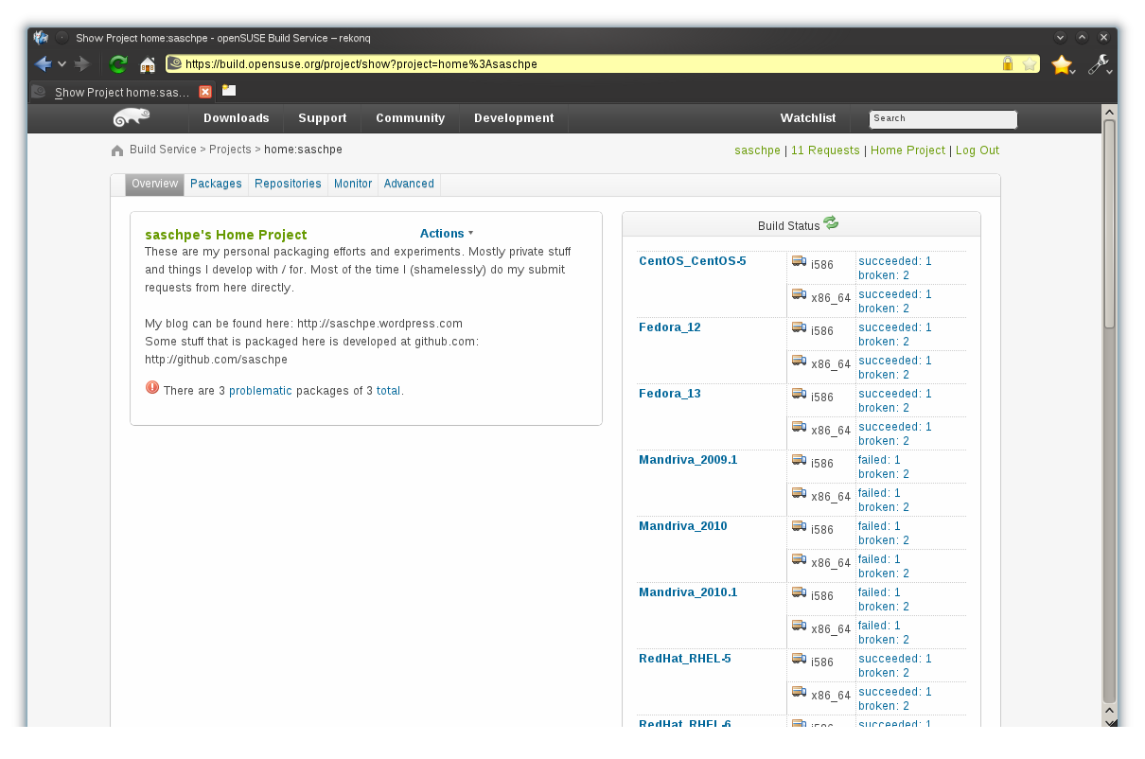
Notes:
This is a home project. You see this user builds for a variety of distro's and architectures, and some packages are not building well.

Slide 11
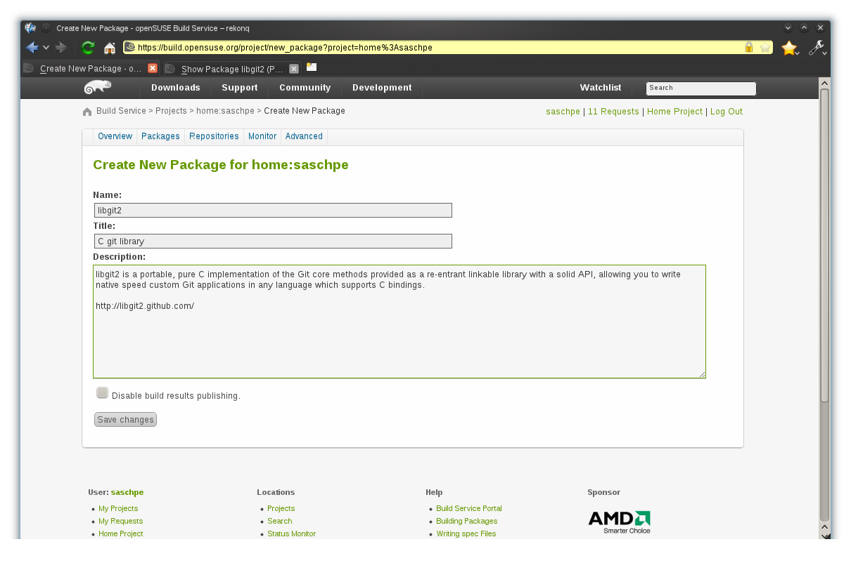
Notes:
Let's create a new package.

Slide 12
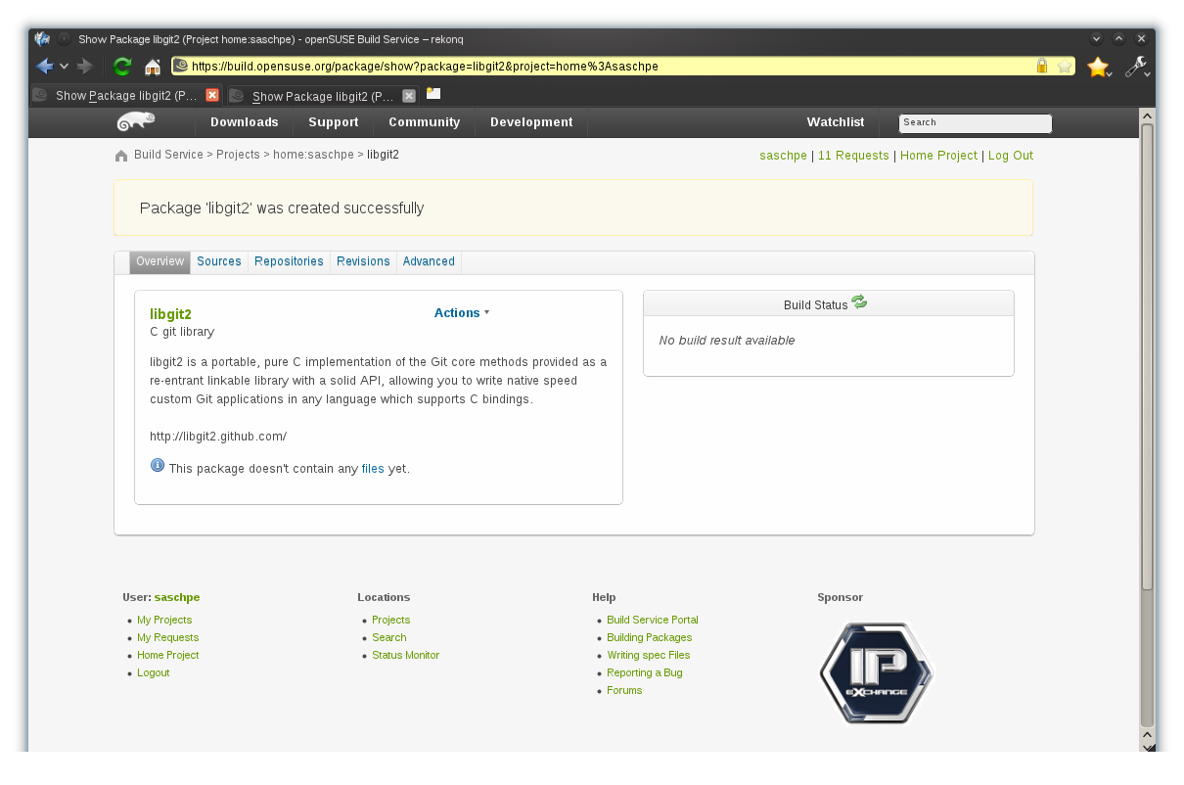
Notes:
Done!

Slide 13
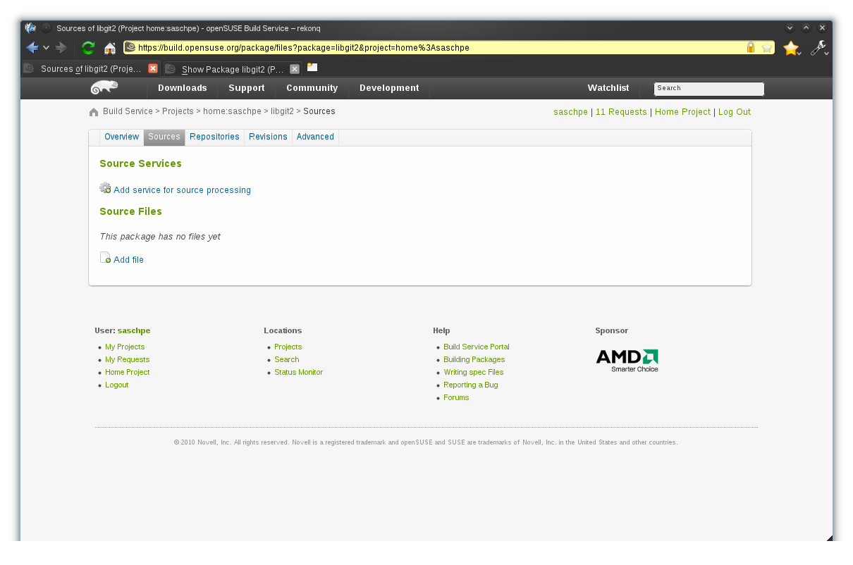
Notes:
Now, let's upload source code. You can let OBS pull directly from a repository like Subversion or git but we'll just upload a tarball.

Slide 14
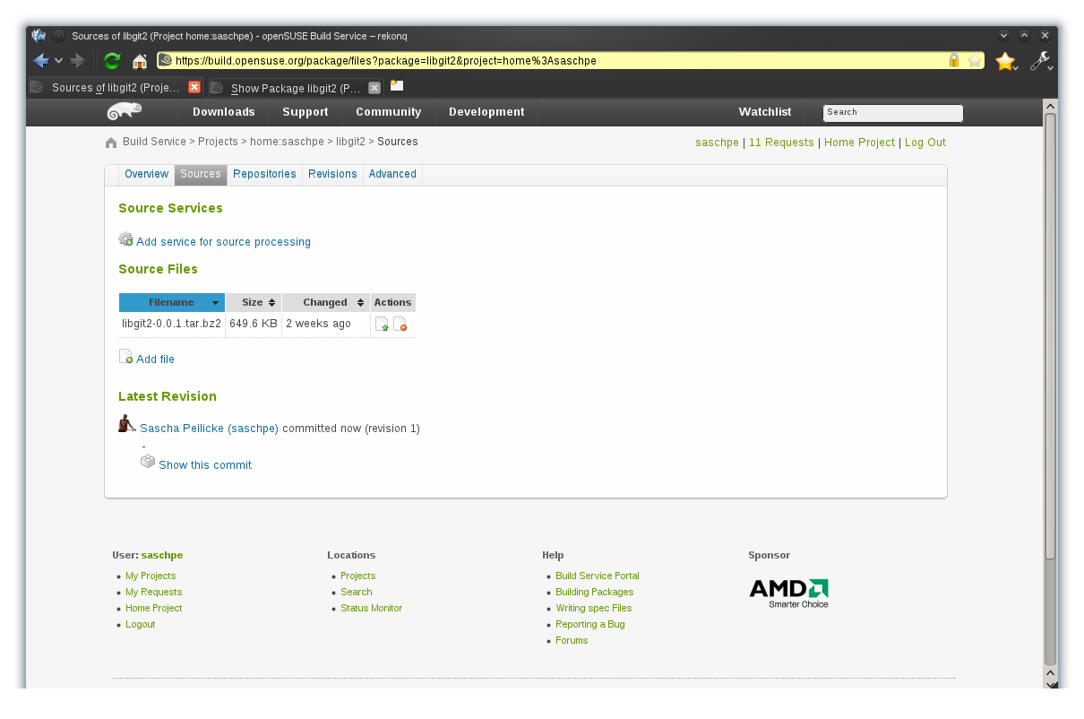
Notes:
Done!

Slide 15
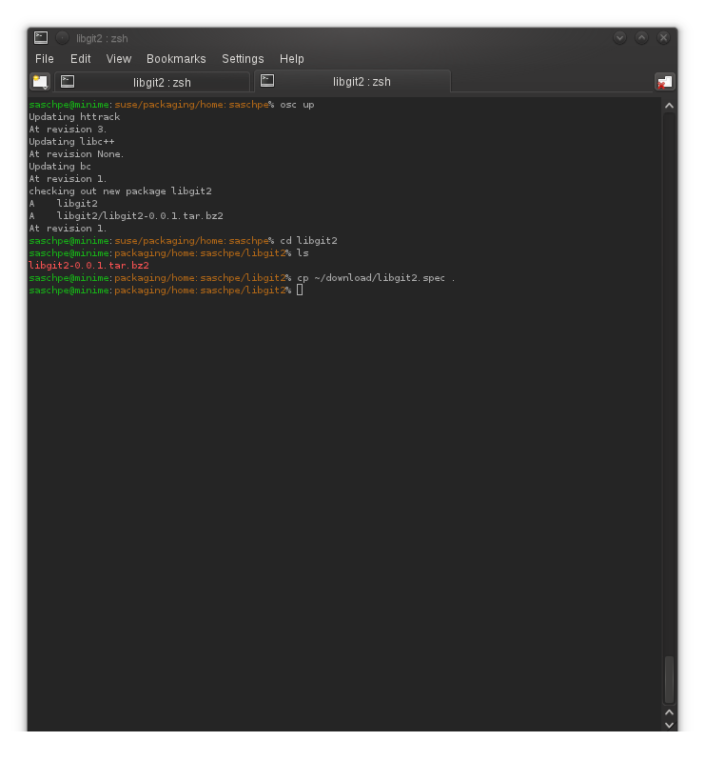
Notes:
You can also work from the command line with OBS, if you like. It works a bit like a source code management tool like subversion – you check out a project and get all the files. You can add and edit files and commit changes.

Slide 16
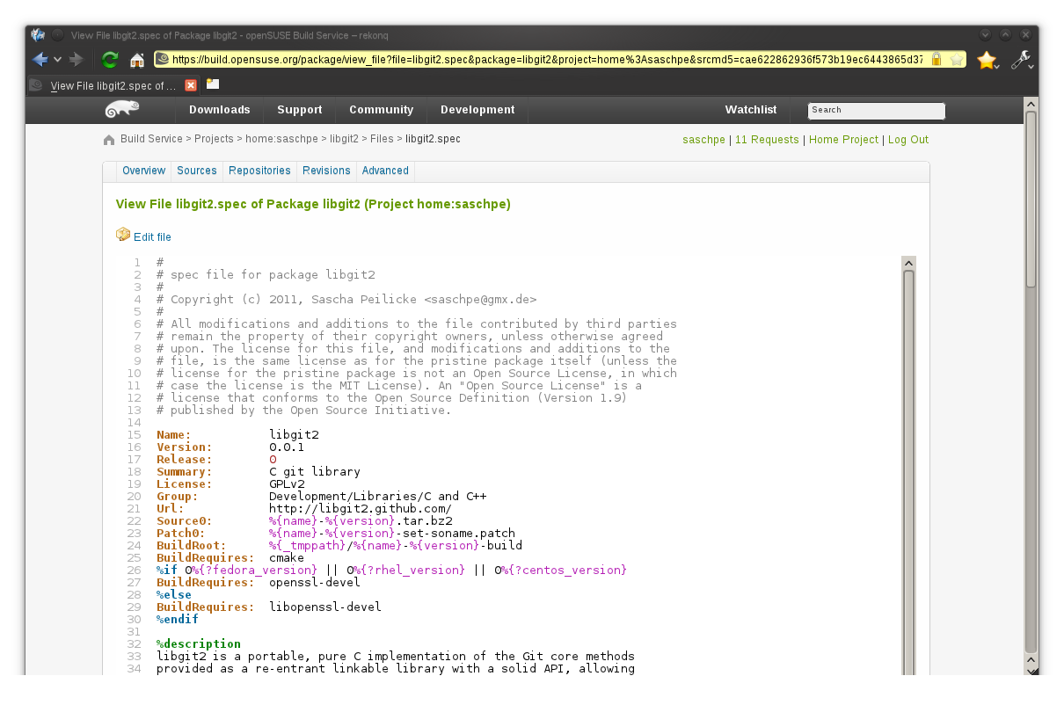
Notes:
But if you want, the whole process can be done from the web browser. Here we can edit a specfile, yes, with syntax highlighting of course!

Slide 17
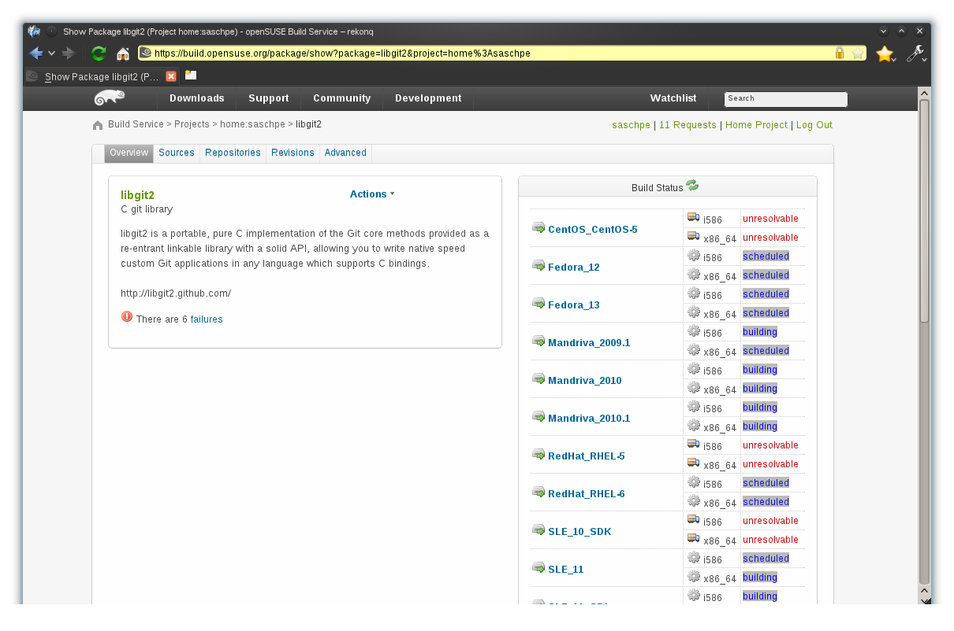
Notes:
Once you've added all files, OBS will start building automatically.
You see a full overview on your home page...

Slide 18
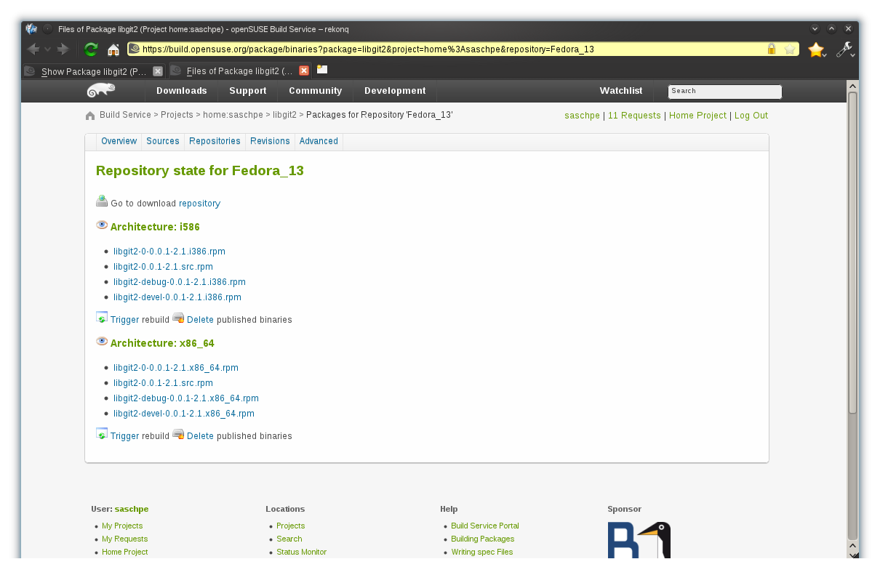
Notes:
… or check the status of individual repositories

Slide 19
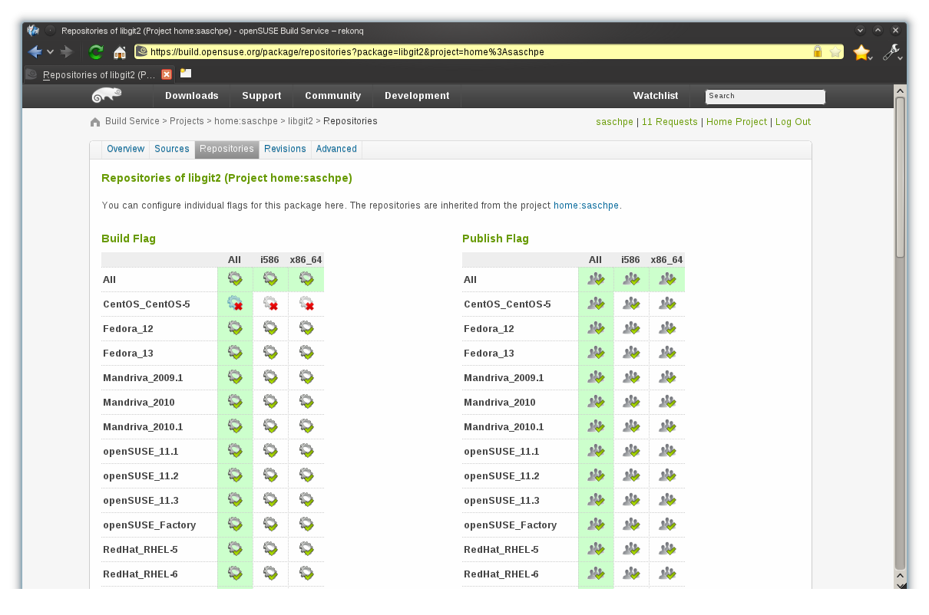
Notes:
If something doesn't build, you can fix it or disable it. Here, CentOS gets disabled because it's just too old to build this. Of course we could also build all it's dependencies or point OBS to a repository which has them, but for now – we just move on.

Slide 20
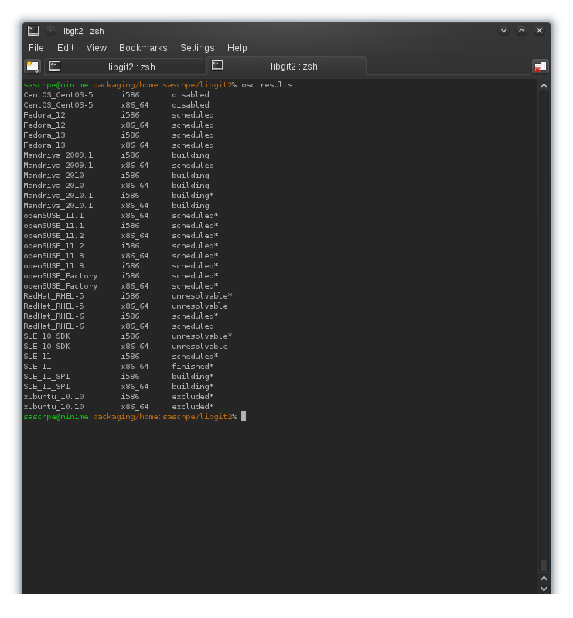
Notes:
See here the same overview from the command line!

Slide 21
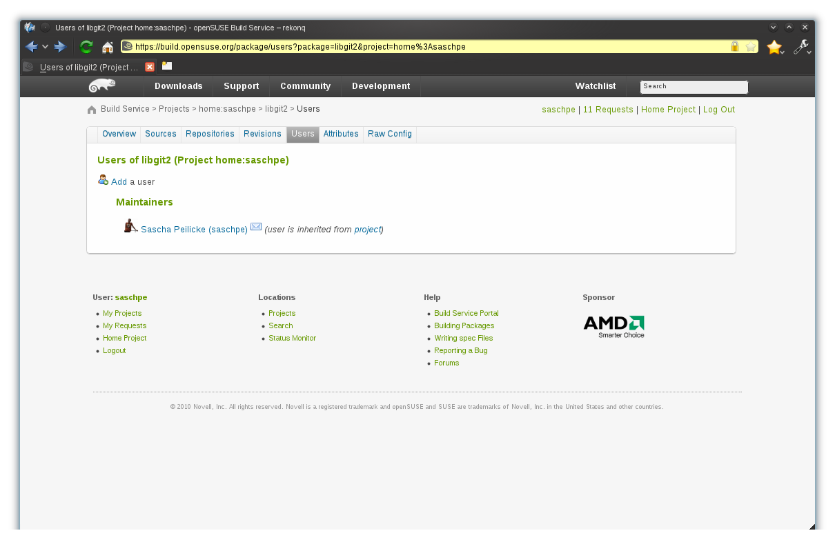
Notes:
If you have trouble with packages which don't build, you can give others access to your project to help you or add other packages to it.
OBS has many big projects around things like KDE, GNOME or development tools like libraries. We should submit our package to one of those!

Slide 22
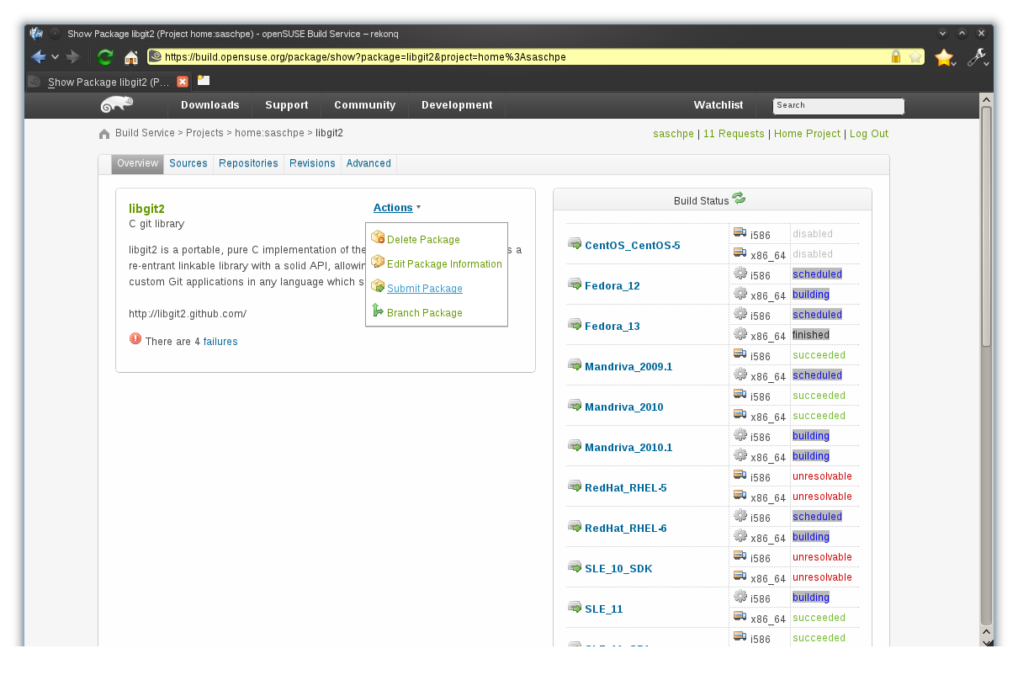
Notes:
So choose the action “submit”

Slide 23
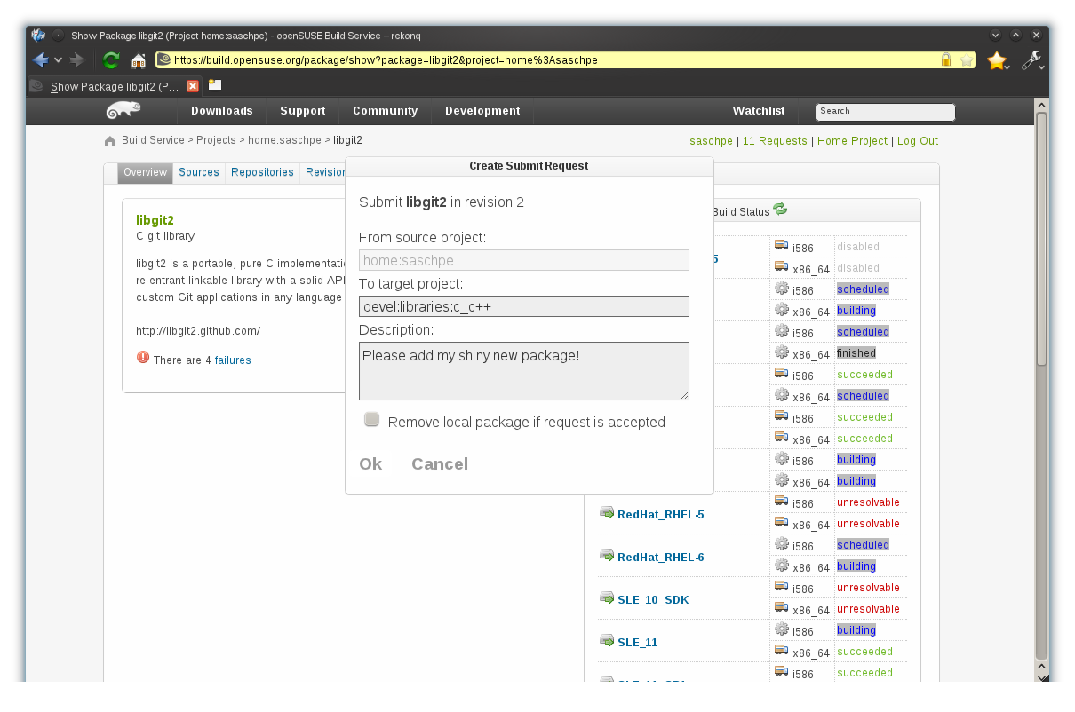
Notes:
And enter the needed details...

Slide 24
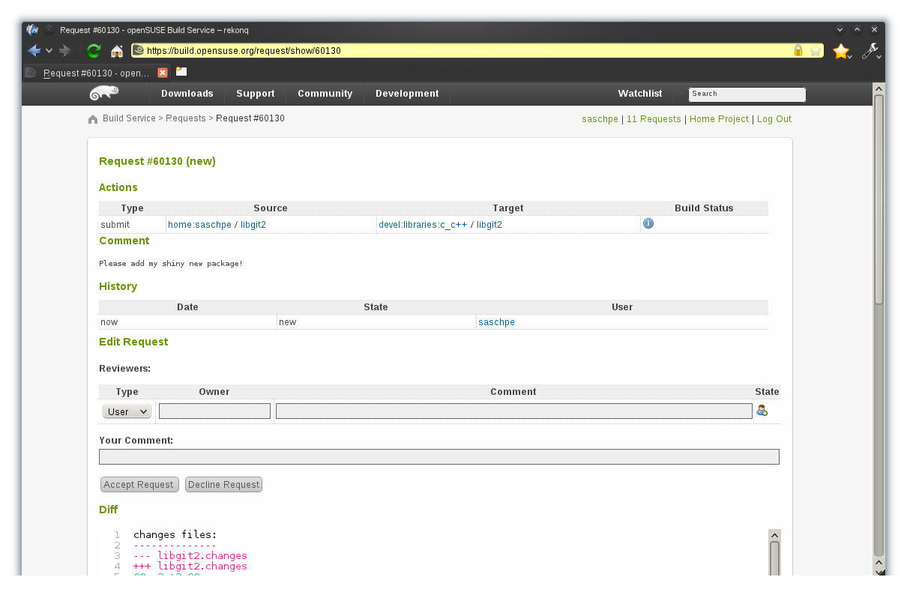
Notes:
A merge request has been made!

Slide 25
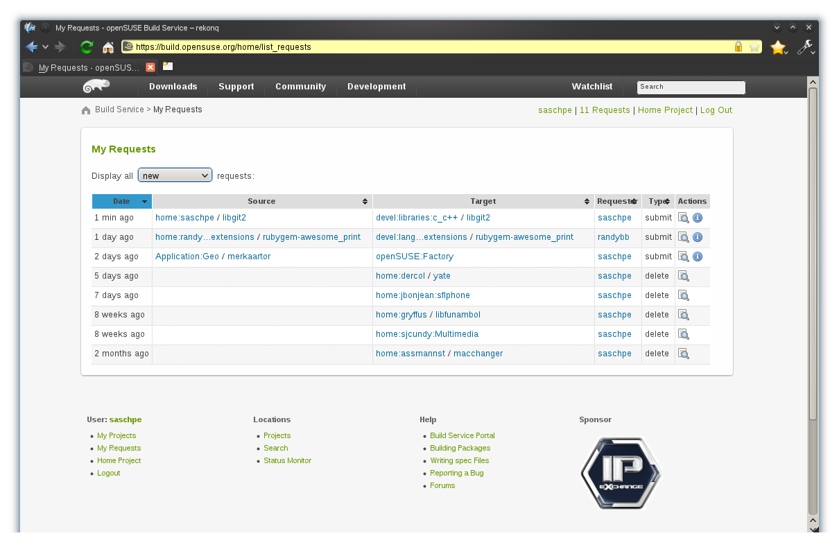
Notes:
And it will be added to your list of GIT requests...
All done!!!

Slide 26
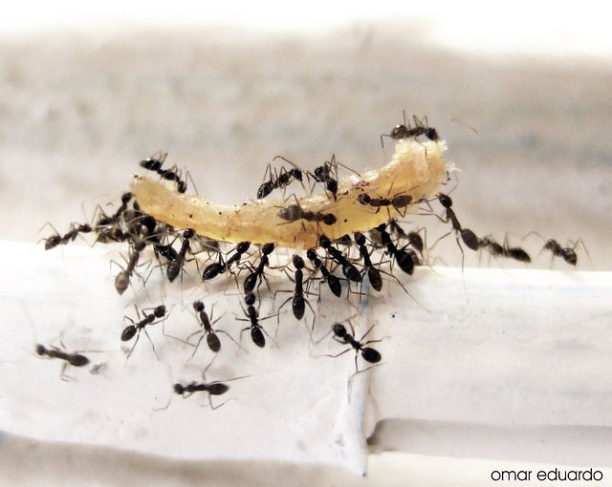
​
Tidy!
Notes:
Now you've seen how easy it is to create packages for Linux.
Forget about complicated and fragile scripts. Build packages, build liveCD's and virtual images, build whole distributions, easy and quick!

Slide 27
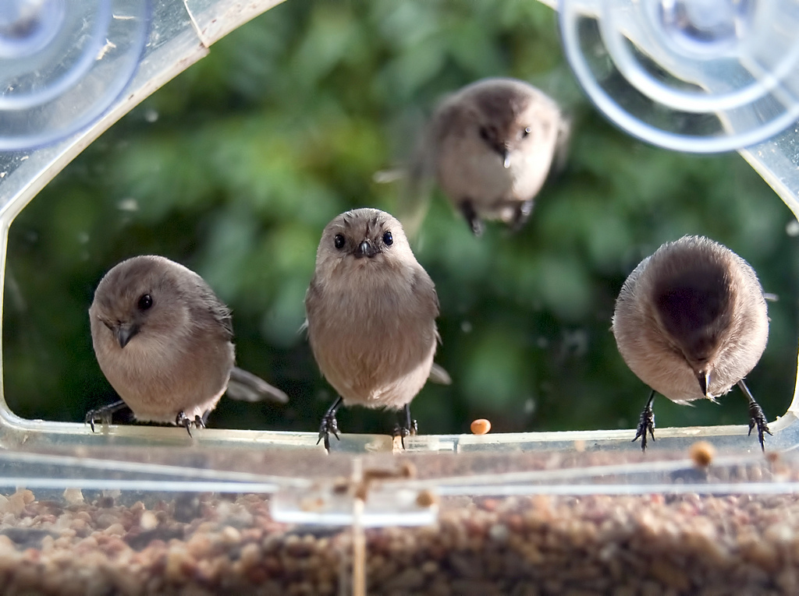
​
It is Free - you can join too!
Notes:
It is Free Software. You can download a virtual image or a hard drive image and get going with your own build server in no time. Join us for questions on
#opensuse-buildservice on Freenode
Go to build.opensuse.org and start building!

Slide 28

Newcomers welcome
Notes:
A kitty which is always looking for new volunteers!
people who actually want to make a difference!
OBS is just one example, the key to openSUSE is OPEN!

Slide 29

opensuse.org
planet.opensuse.org
opensuse.org/Portal:How_to_participate
opensuse.org/Junior_jobs
features.opensuse.org
build.opensuse.org
#opensuse-project

Slide 30
Kitty Image credits
about me: eoshea
Building Something: Adam Foster
Packages: metacheetr
Tidy: omar_eduardo
It is Free: Wink
To be found on Flickr under the above names with a Creative Commons license. Thanks all!

Slide 31
The ultimate Linux Distribution!

